Slide 1
Exception Handling Interface and Thread in Java CSIT751 (PG) (CORE JAVA MODULE III)

Slide 2
Topics Covered:
Exception handling in Java
try, catch, throw, throws and finally
Uncaught Exceptions
Creating and using user defined Exceptions
Multiple catch, Java’s Built-in Exception
Threads in Java
Thread life cycle
Creating and implementing thread
Multi-threaded programming, thread priorities
Synchronization of thread, resuming and stopping Threads

Slide 3
Exception Handling

Slide 4
Types of Errors
There are two categories of errors:
Compile time errors: Syntax errors arise because the rules of the language have not been followed. They are detected by the compiler.
Runtime errors: Runtime errors occur while the program is running if the environment detects an operation that is impossible to carry out.

Slide 5
Example of Compile Time Error
Class Error
{
public static void main(String args[])
{
System.out.println(“Hello Java”)
}
}

Slide 6
Example of Runtime Error
class Error
{
public static void main(String args[])
{
int a=10, b=5,c=5,d;
d=a/(b-c);
System.out.println(“Value of d is: “ + d);
}
}

Slide 7
Exception Handling
Exception is an abnormal condition means result out of expectation. (run time error)
Exception is an event that disturbs the normal flow of the program.
It is unexpected result which we do not think.
Example: Suppose we have defined array with size 5 but we are trying to access array of index 6. So, in this situation exception occurs.

Slide 8
Exception Handling where exceptions may occur
int a=50/0; //ArithmeticException
String s=null; System.out.println(s.length());
// NullPointerException
String s="abc";
int i=Integer.parseInt(s);
// NumberFormatException
int a[]=new int[5]; a[10]=50;
// ArrayIndexOutOfBoundsException

Slide 9
Types of Exceptions
Exception | Meaning
ArithmeticException | Arithmetic error, such as divide-by-zero
ArrayIndexOutOfBoundsException | Array index is out-of-bounds
ArrayStoreException | Assignment to an array element of an incompatible type
NumberFormatException | Invalid conversion of a string to a numeric format

Slide 10
Five keywords used in Exception handling:
try – Defines a block where an exception might occur.
catch – Handles the exception.
throw – Used to throw an exception explicitly.
throws – Declares exceptions that a method might throw.
finally – A block that always executes after try and catch, whether an exception occurs or not.

Slide 11
Example: ArithmeticException (Divide by Zero)
public class JavaExceptionExample {
public static void main(String args[]){
try{
//code that may raise exception
int data=100/0;
}
catch(ArithmeticException e) {System.out.println(e);}
//rest code of the program
System.out.println("rest of the code...");
}
}

Slide 12
Example: ArithmeticException (Divide by Zero until denominator is non-zero)
Click here

Slide 13
finally block
The finally block is a block that is always executed. It is mainly used to perform some important tasks such as closing connection, stream etc.
Rule: For each try block there can be zero or more catch blocks, but only one finally block.

Slide 14
finally block
There are 3 possible cases where finally block can be used:
Case 1: When an exception does not rise
Case 2: When the exception rises and handled by the catch block
Case 3: When exception rise and not handled by the catch block

Slide 15
finally block : Example
import java.io.*;
class DemoFinally{
public static void main(String[] args)
{
try {
System.out.println("inside try block");
// Throw an Arithmetic exception
System.out.println(34 / 0);
}
catch (ArithmeticException e) {
System.out.println(
"catch : exception handled.");
}
// Always execute
finally {
System.out.println("finally : i execute always.");
}
}
}

Slide 16
One Try can have Multiple Catch
try
{
statement;
}
catch(Exception-type-1 e)
{
statement;
}
catch(Exception-type-2 e)
{
statement;
}
catch(Exception-type-N e)
{
statement;
}

Slide 17
Example for Multiple Catch statements
Click here…

Slide 18
throw/throws keyword
If a method does not handle a checked exception, the method must declare it using the throws keyword. The throws keyword appears at the end of a method's signature.
The throw keyword is used to explicitly throw an exception. The throw keyword is mainly used to throw custom exception.

Slide 19
throw keyword
throw:
Used to actually throw an exception.
You use it inside a method or block of code.
Syntax: throw new ExceptionType("Message");
public void checkAge(int age)
{
if (age < 18)
{
throw new IllegalArgumentException("Age must be 18 or older.");
}
}

Slide 20
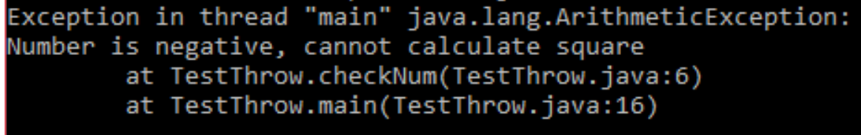
throw Example
public class TestThrow {
public static void checkNum(int num) {
if (num < 0) {
throw new ArithmeticException("\nNumber is negative, cannot calculate square");
}
else {
System.out.println("Square of " + num + " is " + (num*num));
}
}
//main method
public static void main(String[] args) {
TestThrow obj = new TestThrow();
obj.checkNum(-3);
System.out.println("Rest of the code..");
}
}

Slide 21
throws keyword
throws:
Used in a method signature to declare that the method might throw an exception.
It's a warning to the caller that they need to handle or declare the exception too.
Syntax: returnType methodName() throws ExceptionType { }
public void readFile(String fileName) throws IOException
{
FileReader file = new FileReader(fileName);
}

Slide 22
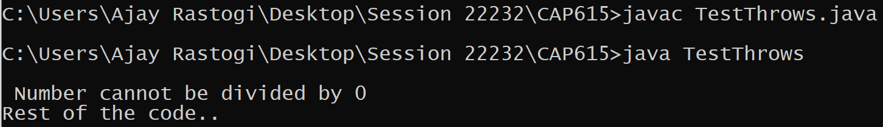
throws Example
public class TestThrows {
public static int divideNum(int m, int n) throws ArithmeticException {
int div = m / n;
return div;
}
//main method
public static void main(String[] args) {
TestThrows obj = new TestThrows();
try {
System.out.println(obj.divideNum(45, 0));
}
catch (ArithmeticException e){
System.out.println("\n Number cannot be divided by 0");
}
System.out.println("Rest of the code..");
}
}

Slide 23
Java Custom (User Defined) Exception
In Java, we can create our own exceptions that are derived classes of the Exception class.
Creating our own Exception is known as custom exception or user-defined exception.
Using the custom exception, we can have our own exception and message.

Slide 24
User Defined Exception Syntax
// class representing custom exception
class MyCustomException extends Exception
{
//code for constructor
}
// class that uses custom exception MyCustomException
public class TestCustomException2
{
public static void main(String args[])
{
try
{
throw new MyCustomException();
}
catch (MyCustomException ex)
{
System.out.println("Caught the exception");
System.out.println(ex.getMessage());
}
System.out.println("rest of the code...");
}
}

Slide 25
User Defined Exception Examples using throw
Example 1, Click here…
Example 2, Click here…

Slide 26
User Defined Exception Example using throws
Click here…

Slide 27
Threads in Java

Slide 28
The life cycle of the thread in java is controlled by JVM. The java thread states are as follows:
Life Cycle of a thread
Basically, there are five state:
New-Born
Running
Runnable
Blocked
Terminated/Dead

Slide 29
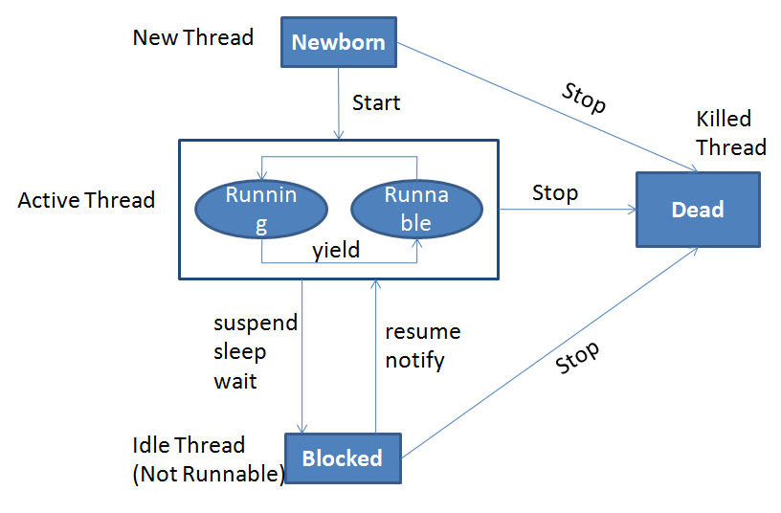

Slide 30
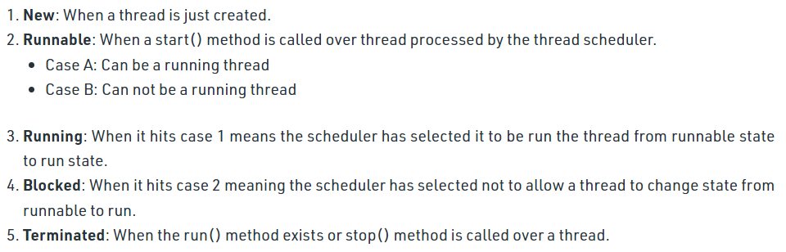
Life Cycle of a thread

Slide 31
Creating and Implementing thread
Two Ways to implement multithreading in Java
Create a class that extends the Thread class
Create a class that implements the Runnable interface

Slide 32
1. Create a class by extending Thread class and override run() method:
class MyThread extends Thread
{
public void run()
{
// thread body of execution
}
}

Slide 33
Create a thread:
MyThread thr1 = new MyThread();
Start Execution of threads:
thr1.start();
Create and Execute:
new MyThread().start();

Slide 34
Example : Using Thread class click here…

Slide 35
2. Create a class that implements the interface Runnable and override run() method:
class MyThread implements Runnable
{
.....
public void run()
{
// thread body of execution
}
}

Slide 36
Creating Object:
MyThread myObject = new MyThread();
Creating Thread Object:
Thread thr1 = new Thread(myObject);
Start Execution:
thr1.start();

Slide 37
Example : Using Runnable interface click here…

Slide 38
Thread Priorities
In Java, each thread is assigned priority, which affects the order in which it is scheduled for running. The threads so far had same default priority (NORM_PRIORITY) and they are served using FCFS policy.
Java allows users to change priority:
Threadobject.setPriority(intNumber)
MIN_PRIORITY = 1
NORM_PRIORITY=5
MAX_PRIORITY=10

Slide 39
Thread Priority Example click here…

Slide 40
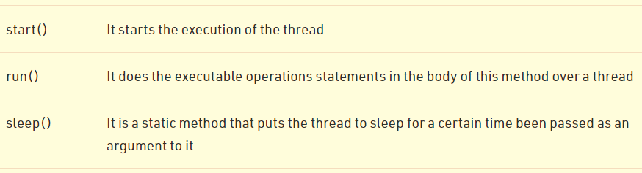
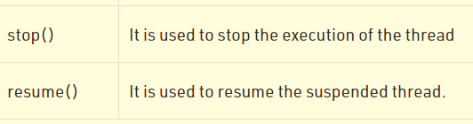
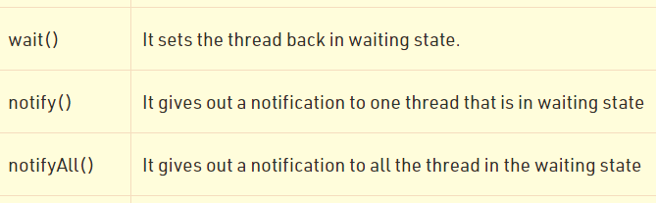
Methods in Thread Class

Slide 41
Thread synchronization
When multiple threads access shared resources, there is a risk of data inconsistency. Synchronization ensures only one thread accesses a critical section at a time.
Need for Synchronization:
Prevents data inconsistency.
Ensures only one thread accesses a critical section at a time.
Maintains thread safety.

Slide 42
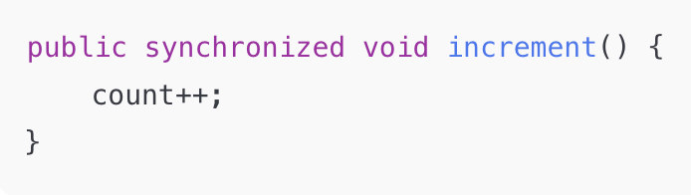
Synchronized Methods
Declare method with synchronized keyword.
Locks the object until method execution completes.

Slide 43
Thread synchronization
Example of synchronization
click here…

